Slide 1
ONLINE STORE ANALYSIS
TATA VIRTUAL INTERNSHIP

Slide 2
Table of contents
01
02
03
04
05
Project Recap
Problem
Process
Data Insights
Recommendation

Slide 3
01
PROJECT RECAP

Slide 4
Project Recap
An online retail store has hired you as a consultant to review their data and provide insights that would be valuable to the CEO and CMO of the business. The business has been performing well and the management wants to analyse what the major contributing factors are to the revenue so they can strategically plan for next year.

Slide 5
02
PROBELM

Slide 6
Problem
Both the CEO and CMO are interested in viewing and understanding how they can use the data to make more meaningful decisions. You would need to provide insights which they can use to create the expansion strategy. The executives want to analyse the trends and the breakdown by different categories so that they have clarity on how the revenue is being generated and what are the main factors affecting the online store.

Slide 7
03
PROCESS

Slide 8
Data Understanding
The dataset contains 541,909 entries with 8 columns:
InvoiceNo | The invoice number associated with each transaction
StockCode | The stock code or identifier of the product
Description | The description of the product
Quantity | The quantity of the product purchased in each transaction
InvoiceDate | The date and time of the invoice
UnitPrice | The unit price of each product
CustomerID | The ID of the customer associated with each transaction
Country | The country where the transaction took place

Slide 9
Data Cleaning
The data has undergone processing using Power Query to ensure its quality and reliability for analysis. Several steps were taken to clean and filter the data, removing any unwanted values that could impact the accuracy of our analysis.
Firstly, we removed entries with negative values in the quantity column, as these would not provide meaningful insights into the business operations.
Additionally, we filtered out unit prices below $0, as they are unlikely to be valid and may introduce inaccuracies in our analysis.
Furthermore, we identified product information that contained question marks, indicating unknown or missing data. To maintain the integrity of our analysis, we excluded these entries from our dataset.
By implementing these corrections and filtering steps, we have ensured that the data used for analysis is accurate and reliable, allowing us to effectively address the business tasks at hand.

Slide 10
DATA INSIGHTS
04

Slide 11
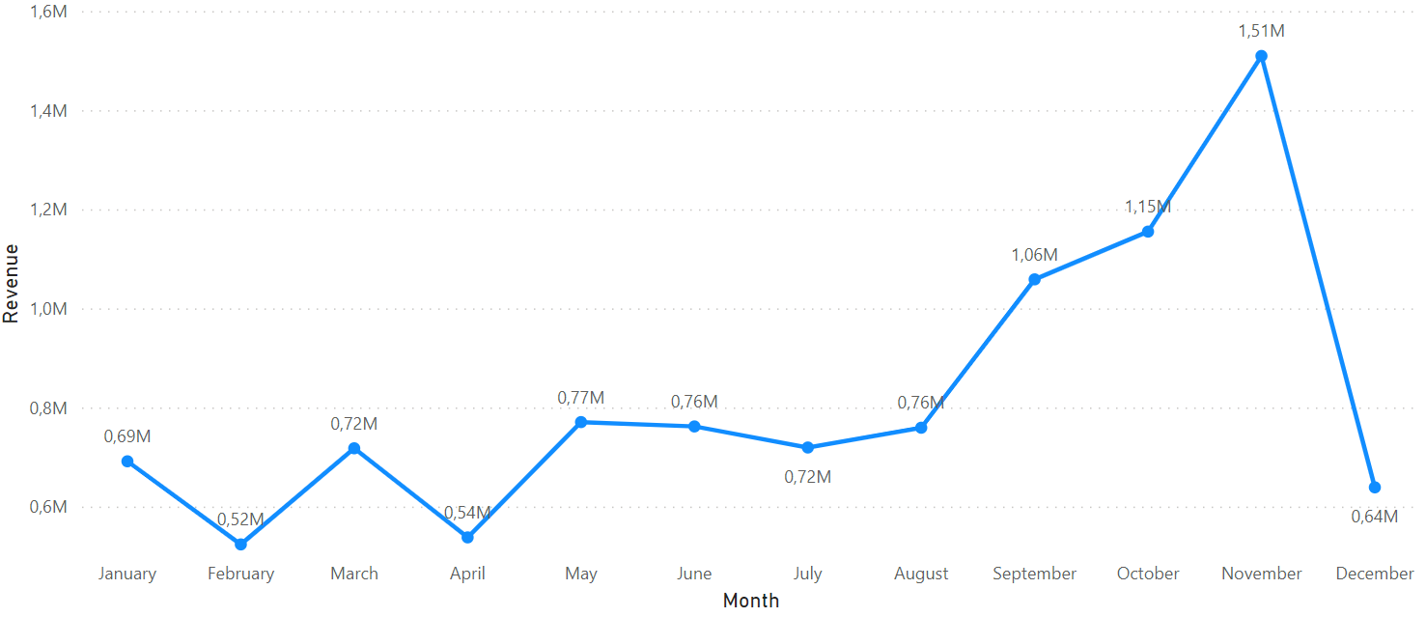
Revenue Trend by Month
February has the lowest revenue, while November has the highest revenue for the online shop in 2014.
The revenue shows a positive trend from August leading up to November.
The data for December is incomplete, so the revenue for that month cannot be confirmed.
The analysis indicates that the retail store sales are influenced by seasonality, particularly during the last four months of the year.

Slide 12
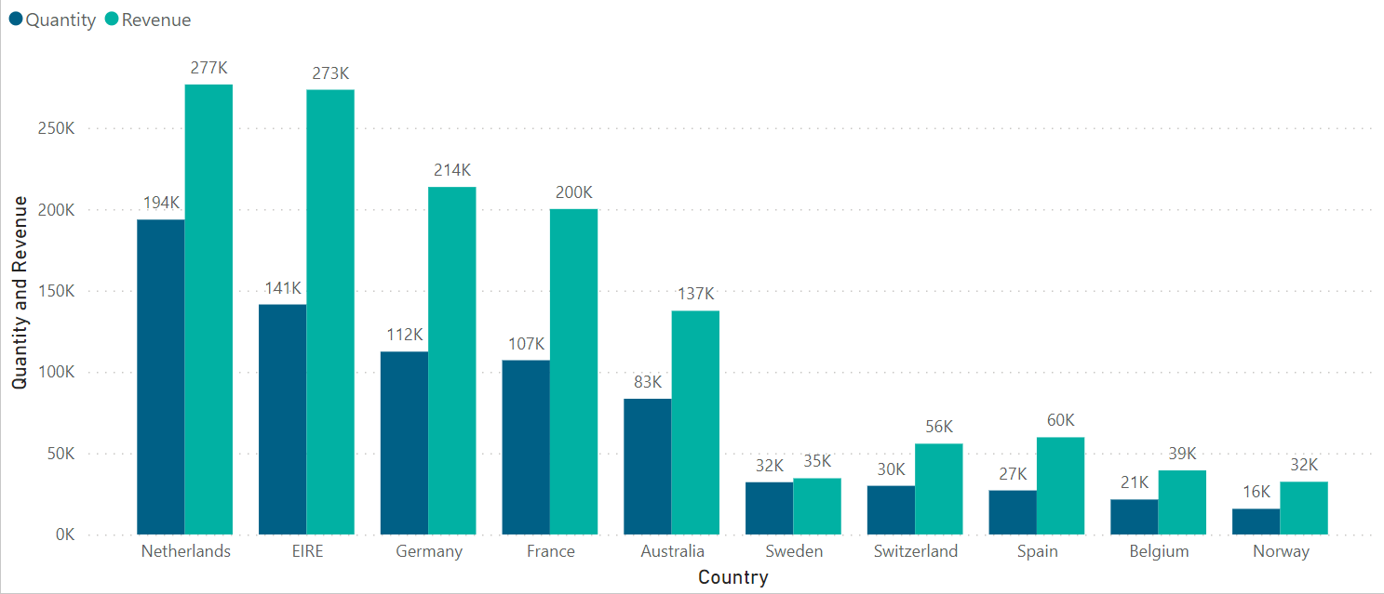
Quantity and Revenue by Country
Neverlands is the country that generated the most revenue and quantity out of 10 countries, followed by EIRE and Germany.
﻿Quantity and total Revenue are positively correlated with each other.
The largest discrepancy between revenue and quantity was observed in the country of EIRE, with revenue exceeding quantity by 132,018, while in the Netherlands, revenue exceeded quantity by 33,000, indicating that prices in the Netherlands are lower compared to EIRE.

Slide 13
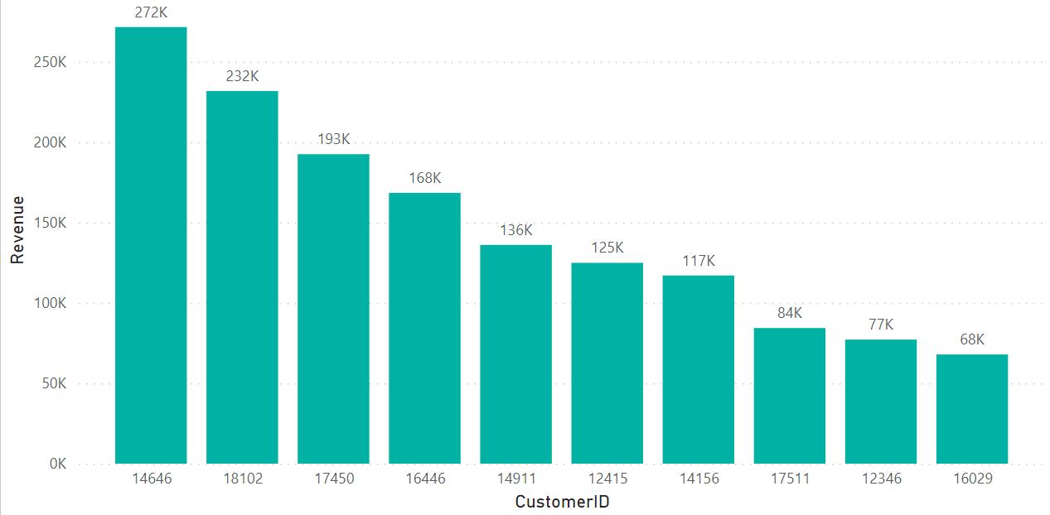
Revenue by Customer
Here we see the top 10 customers by revenue. Customer ID 14646 has revenue 272K and customer ID 18102 has revenue 232K which are among the top revenue generating customers.
﻿Customer ID 14646 accounted for 18,45% of Revenue.﻿
﻿Across all 10 CustomerID, Revenue ranged from $68K to $272K.﻿

Slide 14
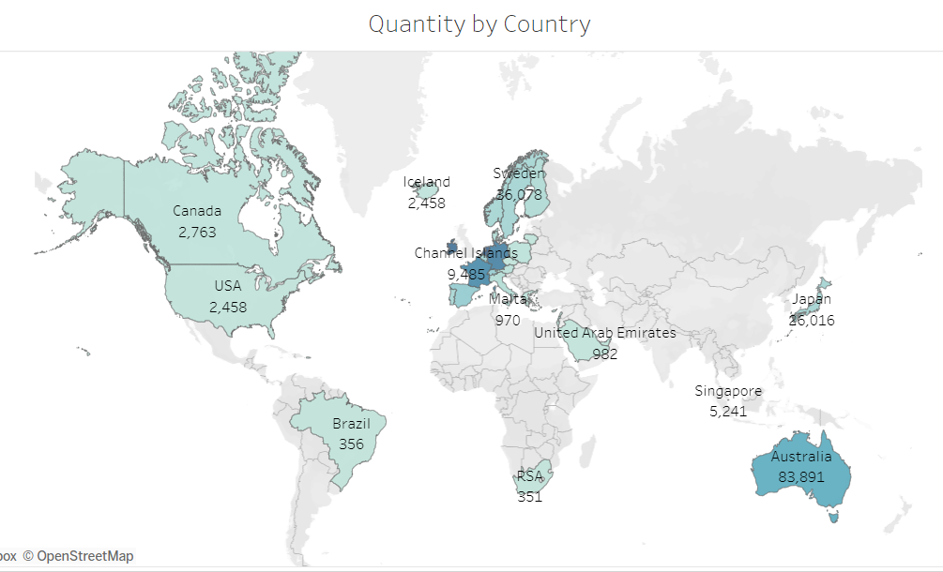
Top 10 Countries by Revenue and Quantity Sold
Netherlands is the country that has the highest quantity which makes it the best country for a business expansion.
Europe seems promising for the popularity of the business.
North American with countries like Canada and USA also has significant revenues that can also be a good opportunity to invest in.

Slide 15
Recommendation
The revenue data for December is incomplete, but it indicates a promising increase since July, with a steady uptrend observed from July to December, suggesting a seasonal trend.
The Netherlands, Ireland, and the surrounding areas have generated significant revenue and have a substantial customer base, presenting expansion opportunities for the company.
The top customers show an average revenue starting at $272K, then decreasing to the range of $232K, and drastically falling to the $68K range.
Recommendation: Based on the successful performance in the Netherlands, Ireland, and surrounding areas, the store should consider focusing on expanding its presence and marketing efforts in these regions to further capitalize on the existing customer base and revenue potential.

